Slide 1
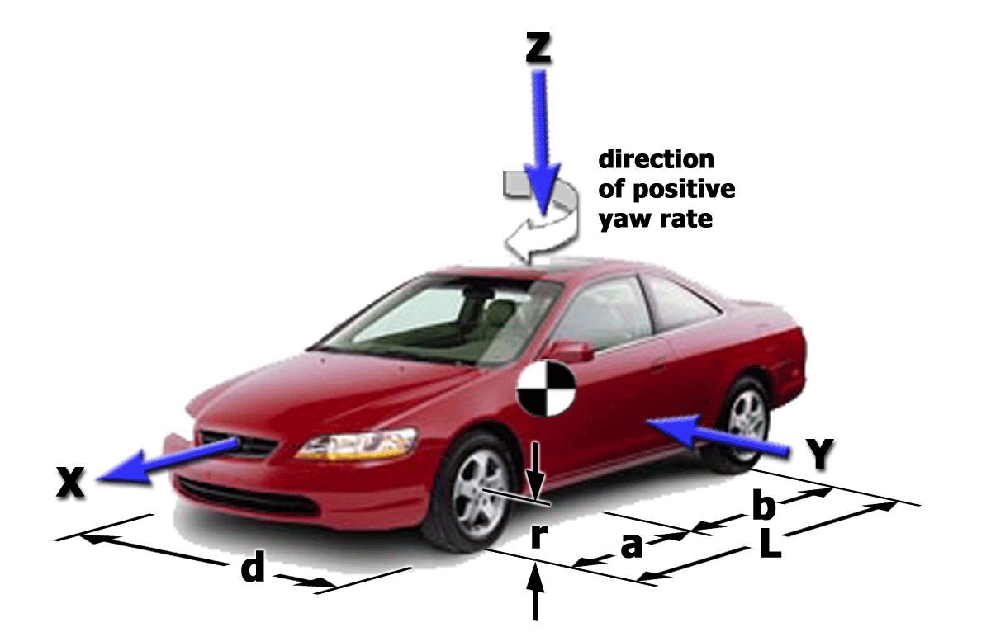
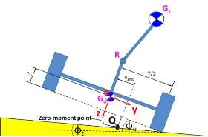
Automotive Vehicle Dynamics
Lecture 05 – Vehicle Coordinate Systems
Sean Brennan
Department of Mechanical Engineering
Penn State University
sbrennan@psu.edu

Slide 2
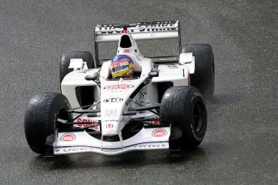
Goals of this lecture?
Understand directions of X, Y, and Z for vehicles
Understand SAE and ISO coordinate conventions (should be able to draw them on the vehicle here)
Know how to undergo rotations from earth to body-fixed (planar motion)

Slide 3
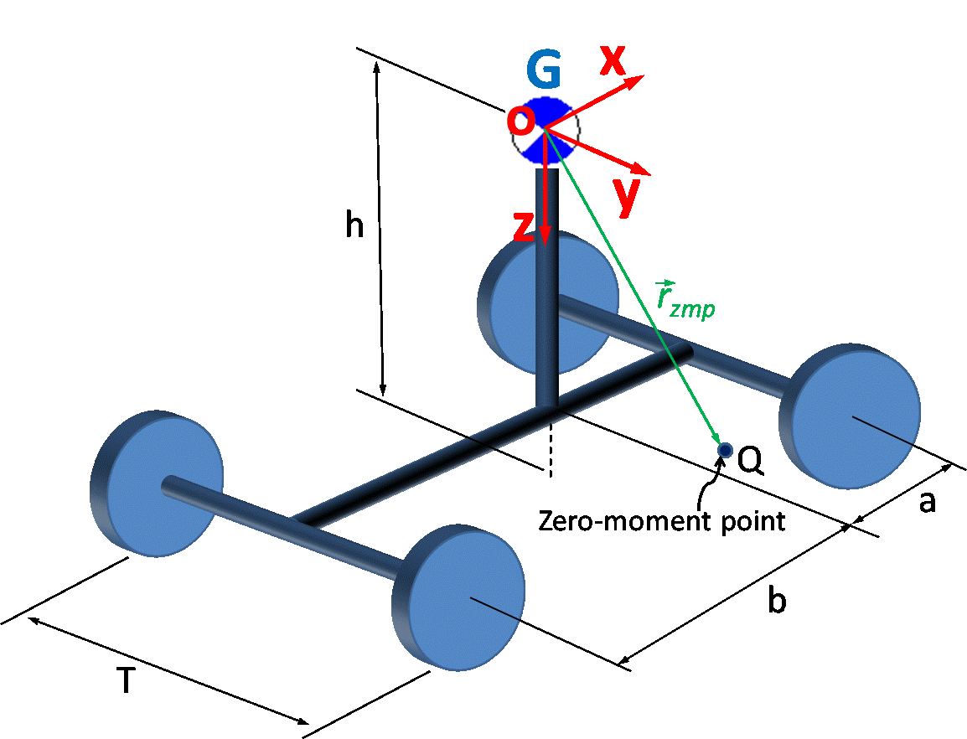
The definition of body-fixed X, Y, and Z are obvious from fact that ordering is arranged by magnitude of typical velocities
Which direction moves most? This is X!
Second most? This is Y.
Least? This is Z.

Slide 4
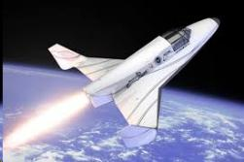
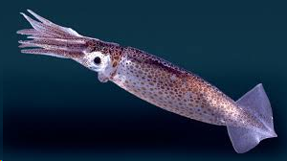


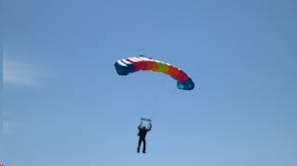
Given that, what would be obvious coordinate directions for…?

Slide 5
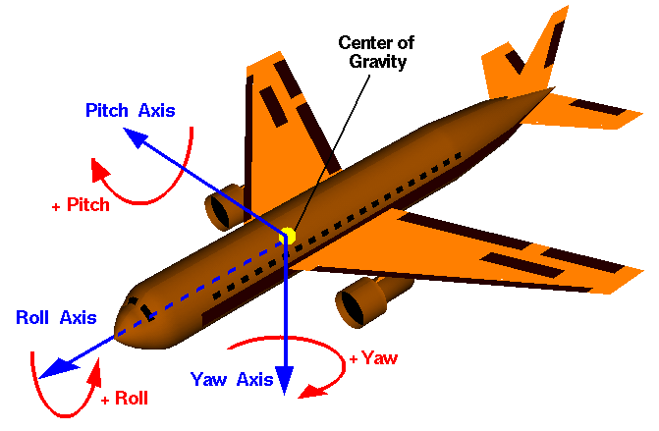
It can be harder to remember directions and words for rotation.

Slide 6
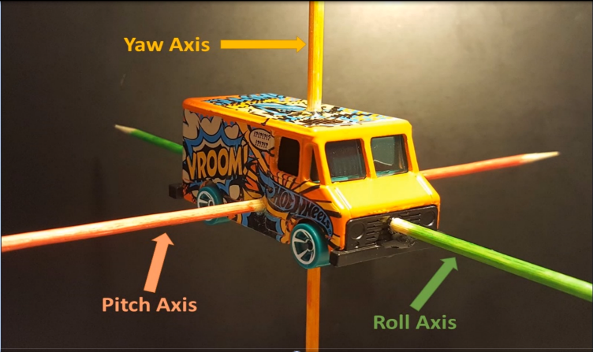
It can be hard to remember directions and words for rotation.

Slide 7
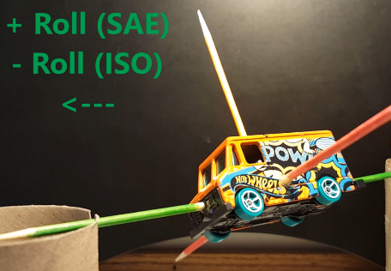
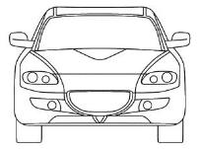
In roll, rotation occurs about the x-axis
Positive Roll in SAE
(crushes passenger)

Slide 8
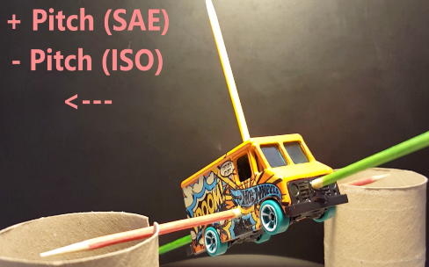
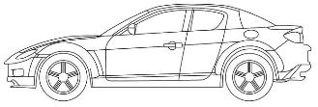
In pitch, rotation occurs about the y-axis
Positive Pitch
(likes to accelerate)

Slide 9
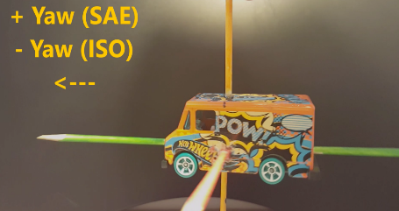
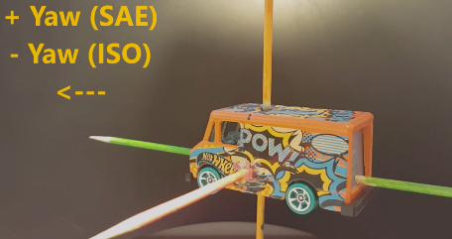


In yaw, rotation occurs about the z-axis
Positive Yaw in SAE
(gives driver better view)

Slide 10
Vehicle Axis Systems? – SAE Pitch
Vehicle pitches around the y-axis, which points laterally to
the right of the vehicle. Note: X indicates tail of axis “arrow”
Positive Pitch
(Americans like to accelerate)
Negative Pitch
Fig. Ref. Highend3d.com

Slide 11
Vehicle Axis Systems? – ISO Pitch
Vehicle pitches around the y-axis. The y-axis is
now to the left of the vehicle in ISO coordinates
Positive Pitch
(Europeans like to brake)
Negative Pitch
Fig. Ref. Highend3d.com

Slide 12



Vehicle Axis Systems? – SAE Yaw
Yaw is around z-axis. Z-axis points into the page.
Positive Yaw
(gives driver better view)
Negative Yaw
Fig. Ref. Highend3d.com

Slide 13
Vehicle Axis Systems? – ISO Yaw
Yaw is around z-axis. Z-axis is now pointing up out of the page, so yaw is reversed from SAE
Positive Yaw
(gives driver better view – in England)
Negative Yaw
Fig. Ref. Highend3d.com

Slide 14
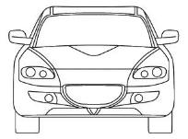
Vehicle Axis Systems? – SAE Roll
Vehicle rolls about the x-axis
Positive Roll
(crushes passenger)
Negative Roll
Fig. Ref. Highend3d.com

Slide 15
Vehicle Axis Systems? – ISO Roll
Vehicle rolls about the x-axis, same as SAE roll, but the positive roll direction is reversed from SAE
Positive Roll
(crushes passenger – in England)
Negative Roll
Fig. Ref. Highend3d.com

Slide 16
Where is this defined?
References:
Definition of SAE: “Vehicle Dynamics Terminology,” SAE J670e, Society of Automotive Engineers, Warrendale, PA.
Definition of ISO: ISO 8855: 1991, “Road Vehicles – Vehicle Dynamics and Road-Holding Ability – Vocabulary,” The International Organization for Standardization, Geneva, Switzerland, 1991 (also available as BS AU 244: 1992, “Glossary of Terms for Road Vehicle Dynamics and Road Holding Ability,” British Standards Institution, Milton Keynes, England, 1992).
Both documents available on the Box account

Slide 17
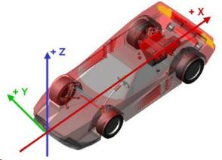
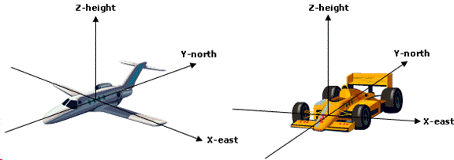
Watch out for mix-ups!
Many – particularly on the internet – often impose their OWN coordinate systems (and units) and this can cause huge problems in understanding the resulting equations
http://edndoc.esri.com/arcobjects/9.2/NET/b0e91ce8-c180-47dc-8323-06cac5d77064.htm

Slide 18
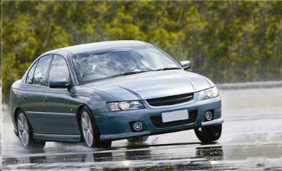
Velocities are what we are most interested in…
Lateral velocity of vehicle to the right = positive, along positive y-axis
So, for a high-speed right-hand turn, lateral velocity is to the left and vehicle experiences negative lateral velocity and positive yaw rate

Slide 19
Measurement of sideslip, tire slip, and steer angle can be tricky
SAE Convention considers overhead view
clockwise = positive direction (CW+), and
counterclockwise negative (CCW-).
Always measure the angle from real to imaginary
Sideslip Angle β: from body to travel path of CG
Tire Slip Angle α_{f}, α_{r} : from tire to tire travel path
Or from larger component to smaller
Steer Angle δ: from body to tire

Slide 20
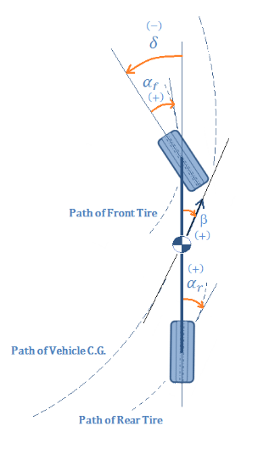
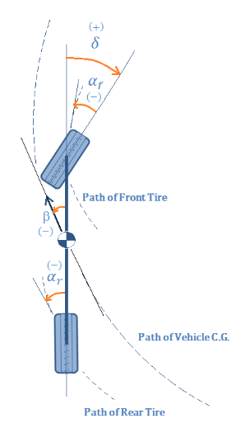
Example: what are typical signs for a high-speed turn?

Slide 21
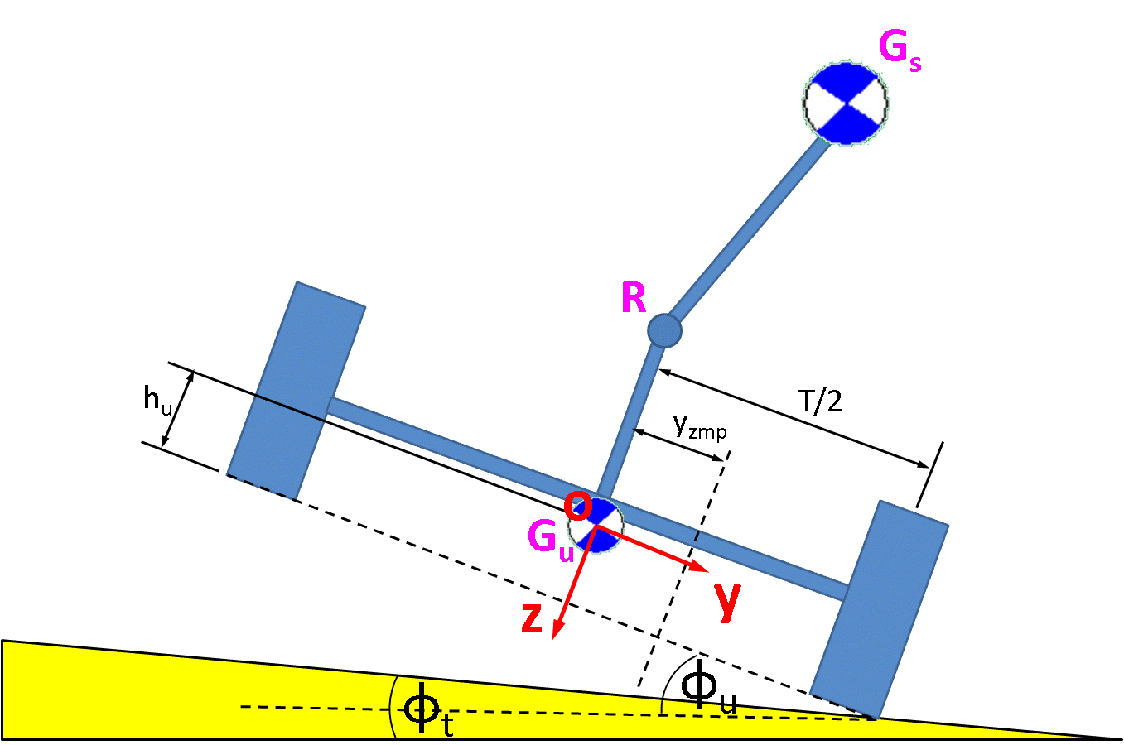
What if the body rolls? We use 2 different coordinate systems then
Unsprung Mass is a rigid frame with steerable wheels
Sprung Mass is a rigid body
Two are “hinged” together at roll axis
Vehicle dynamics are measured from UNSPRUNG mass (hard, since this is a fictitious object!)

Slide 22

On some vehicles, drivers can use weight shift to affect “sprung mass” to cause wheel lift
Notes:
In the video, as the motorcycle turns on the hill, the sprung mass’s center of gravity shifts to the right and causes the motorcycle to roll. The sprung mass’s center of gravity is then shifted back over top of the front wheel and the right rear tire to maintain its balance on the two tires, keeping the bike from rolling completely over. Then, at the end of the video, the driver shifts the center of gravity to the other side of the motorcycle to bring the bike back down. Video by Nick Williams and Nathan Vitacco in Spring 2016 class.

Slide 23
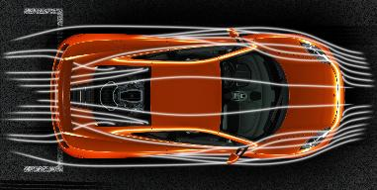
What about aerodynamics?
By convention, the coordinate system center in this case is at midpoint between tires, both front-to-back and right-to-left
We will NOT use this convention in this class
http://www.eurocarnews.com/25/0/0/2215/mclaren-mp4-12c-aerodynamics-orange-image/gallery-detail.html

Slide 24
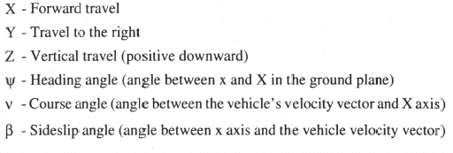
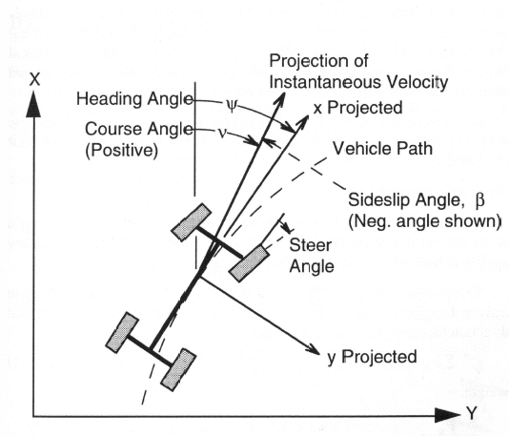
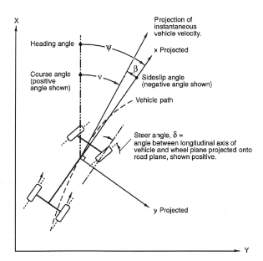
Case of Copy-Cat Coordinate System Cads
Ref. Fundamentals of Vehicle Dynamics, 1992,
Thomas D. Gillespie, Society of Automotive Engineers, Inc, p. 9
Ref. Milliken & Milliken, Race Car Vehicle Dynamics, SAE Press 1995, p. 118-119

Slide 25
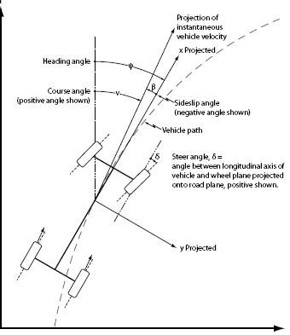
My version!

Slide 26
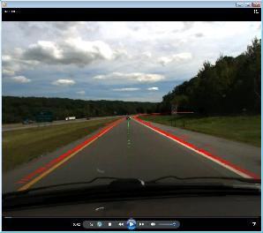
The choice of coordinate systems is not critical if we know how to convert form one to another
Let’s first consider body-fixed coordinates, and conversion from these to the ground, aka “global” coordinates.
The coordinate system will be a right-handed coordinate system meaning that all relations will be clockwise about the axis of rotation.

Slide 27
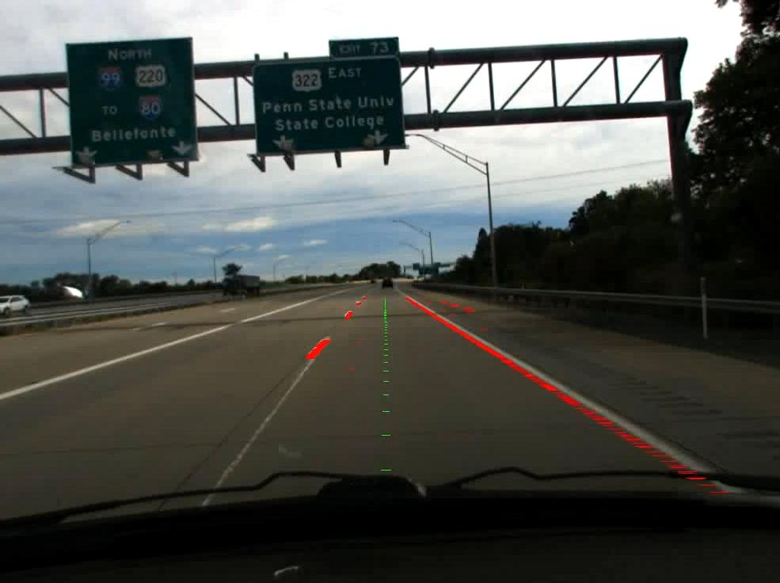
Body-to-global coordinate conversions are common in registering sensor information to a map

Slide 28
Dynamicists often use capitalization to indicate GLOBAL vs local coordinates
We’ll do the same, as follows. (usually) x = longitudinal position y = lateral position z = vertical position X Y Z
lower-case =
body-fixed
UPPER CASE =
earth fixed

Slide 29
… except velocities are often capitalized (I’m not sure why!)
U = longitudinal velocity V = lateral velocity W = vertical velocity p = roll rate φ = roll angle q = pitch rate θ = pitch angle r = yaw rate ψ = yaw angle
body
fixed
body
fixed

Slide 30
We’ll be talking a LOT about inertial coordinates soon…
In addition to axes fixed to the vehicle, there are axes that are fixed to an inertial point. These are called earth-fixed axes or just “fixed” axes. A common one is East-North-Up or ENU for short.
Y (north)
2-D case
X
Y
neglecting z
x
earth
fixed
Y_{o}
θ
y
X (east)
X_{o}

Slide 31
Technically, these earth-fixed coordinates are NOT inertial
In case you didn’t know, the Earth is moving VERY fast. A good vehicle gyroscope can measure this even when parked, and hence determine latitude / orientation!
Image by Wikiscient [CC BY-SA 3.0 (http://creativecommons.org/licenses/by-sa/3.0), GFDL (http://www.gnu.org/copyleft/fdl.html), GFDL (http://www.gnu.org/copyleft/fdl.html) or CC BY-SA 3.0 (http://creativecommons.org/licenses/by-sa/3.0)], via Wikimedia Commons, using NASA's "Visible Earth" image (in the public domain)

Slide 32
How to perform a coordinate transform?
The relationship between earth-fixed and body-fixed coordinates consists of three rotations and one translation for the general case. Coordinate rotations START from the fixed axis, and then rotate until they coincide with the body axis.

Slide 33
The coordinate transformation in 2-D can be derived by hand
Y₁
θ₀
Y₀
y₀
P
X₁
x₁
θ₀
x_{o} = x₁ cosθ_{o} – y₁ sinθ_{o}
y_{o} = y₁ cosθ_{o} + x₁ sinθ_{o}
y₁
X₀
x₀
or

Slide 34
Real transformations are usually 3D, and we can’t arbitrarily specify angles
If position in the earth-fixed coordinate systems is defined by a 3×1 vector
Then the rotation is the same as multiplication by a transformation matrix consisting of functions of the rotation angle.
Note that these rotations are not unique and changing the order of the rotation will give different transformations. This is due to the fact that, in general for matrices
To illustrate the issues with ordering, let’s do the coordinate-system hokey-pokey!
A × B ≠ B × A

Slide 35
Convention is important!
To go from earth-fixed coordinates to body-fixed coordinates involves three rotations, (let’s neglect translation for now). Start in earth-fixed, then
1st, rotate about the yaw (Z) axis 2nd, rotate about the pitch (Y) axis 3rd, rotate about the roll (X) axis
Then the revolved coordinates will be aligned with the body-fixed coordinates.
Updated 2008/02

Slide 36
Graphically

Slide 37
Step 1: Coordinate Transformation
To rotate the axes about the yaw (Z) axis gives
If the “sun” is at infinite “z” height, this rotation results in aligning the “shadow” of the body-fixed x and y axes with the global x and y axes.

Slide 38
Step 2: Coordinate Transformation
To rotate the axes about the pitch axis (Y)
This now aligns the rotated body-fixed X-axis with the global X-axis

Slide 39
Step 3: Coordinate Transformation
To rotate the axes about the roll axis (X) gives:
This last rotation aligns the rotated body-fixed axes to the global axes.

Slide 40
The last thing to consider is translation to align origins
The original coordinates [ X_{o}, Y_{o}, Z_{o} ]^{T} are the earth-fixed coordinates.
The new coordinates [X₃, Y₃, Z₃ ]^{T} are very close to the body fixed coordinate. The only difference is a translation.
P

Slide 41
We can put each rotation matrix into one BIG matrix
∴The relationship between earth-fixed and body-fixed coordinates is:
X
Y
Z
x
y
z
+ displacement
vector
=
R_{Z} R_{Y} R_{X}
earth
fixed
body
fixed
earth
fixed

Slide 42
Summary
The transformations are:
Where C is cosine, and S is sine.
Typically, we use velocity transformations, not positions. (Why?)
See http://en.wikipedia.org/wiki/Euler_angles for more info

Slide 43
Coordinate transformation from global to body?
The process can be reversed and the position in body fixed coordinates can be found relative to earth fixed coordinates.
x
y
z
X
Y
Z
;
=
(R₁ R₂ R₃)⁻¹
body
fixed
earth
fixed
since the
transformation is
orthogonal

Slide 44
Body-fixed and earth-fixed, what’s our favorite?
Most of the work in this class will derive dynamic relationships in body-fixed coordinates.
Why then should we consider earth fixed coordinates?
Our GPS system measures in earth-fixed for our test vehicles
Sometimes it’s easier to visualize what’s happening if we switch to earth-fixed coordinates. Particularly if we’re not used to dealing with body-fixed coordinates.
F=ma is often derived in (sorta) earth-fixed coordinates

Slide 45
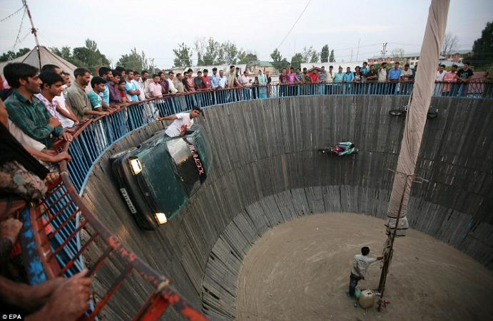
Example: Let’s figure how fast a car spins in yaw when driving in a circle!
See this in action at: https://www.youtube.com/watch?v=QcdlGjAP0xs

Slide 46
Example: Let’s figure how fast a car spins when driving in a circle!
Assume car moving with constant forward velocity around a circle. U = const V = 0 r = U/R
We get this from examining the distance traveled in 1 rev. and comparing it with the time taken. distance = 2πR and time =
yaw rate
radius of curvature
distance 2πR
=
speed U

Slide 47
The total yaw angle to go around a circle is 2π
Therefore yaw rate r =
angular displacement
time
=

Slide 48
People don’t (usually) think in body-fixed coordinates
It would be easier for us to visualize the movement in earth-fixed coordinates.
X
x
t
vs.
body
fixed
earth
fixed
ψ
Y
t

Slide 49
What are we going to use in this class?
We generally use the transformation for velocities to convert from body-fixed to earth-fixed
(Note: this slide will be very useful in your homework!)
(
)
d
X
Y
=
cosψ -sinψ
sinψ cosψ
d
x
y
dt
earth
fixed
dt
body
fixed

Slide 50
How to get positions from velocities?
Since V_{X} = Ucosψ - Vsinψ V_{Y} = Usinψ + Vcosψ
Where allows us to solve for the yaw angle
Integrating these equations gives the circular vehicle path in earth-fixed coordinates, which gives earth-fixed vehicle paths that we’d expect to see if we were a bird watching from above.
earth
fixed
body
fixed

Slide 51
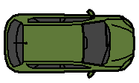
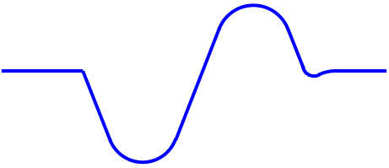
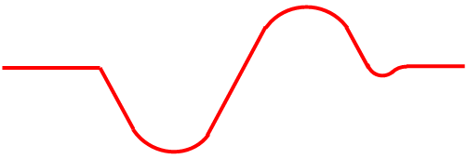
We will use these transformations between body-fixed and earth-fixed coordinates when discussing the planar dynamics of the vehicle
Lane change
(driver’s perception)
Lane change
(vehicle’s perception)
lateral velocity
yaw
rate
t
Notes:
Lesson 4, Slide 34

Slide 52
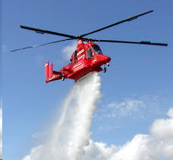
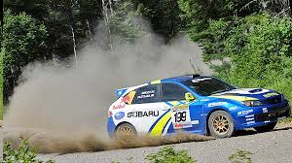
Review
What are X, Y, and Z in the following helicopter (it mostly moves up/down)?
Can you draw SAE coordinates on the following vehicle? What is the lateral velocity of this vehicle in SAE?
A vehicle has a constant positive yaw rate but negative constant lateral velocity and constant forward velocity. What maneuver is it doing?

